Slide 1
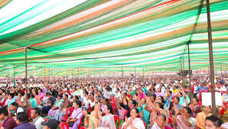


AtliQ Media
Insights from Lok Sabha elections of 2014 & 2019

Slide 2
Agenda
AtliQ Media is a private media company that wants to telecast a show on India’s 2024 Lok Sabha elections. They want Peter who is a data analyst to present insights from the 2014 & 2019 elections without any bias and discuss less explored themes like voter turnout percentage in India.

Slide 3
Goal
Analyse and answer the questions and present insights by exploring primary data and research using secondary data if required. Finally, provide recommendations to the Election Commission of India based on these insights.

Slide 4


Microsoft Power BI

Slide 5
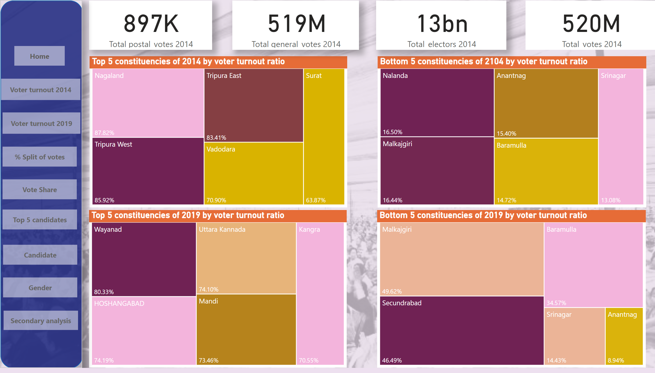
Voter turnout 2014
Notes:
Top 5 constituencies of 2014 by voter turnout ratio
No alt text provided
Top 5 constituencies of 2019 by voter turnout ratio
No alt text provided
Bottom 5 constituencies of 2019 by voter turnout ratio
No alt text provided
Bottom 5 constituencies of 2104 by voter turnout ratio
No alt text provided
card
No alt text provided
card
No alt text provided
card
No alt text provided
card
No alt text provided
shape
No alt text provided
Home
No alt text provided
Voter turnout 1
No alt text provided
Voter turnout 2
No alt text provided
% Split of votes
No alt text provided
Vote share
No alt text provided
Vote share
No alt text provided
Candidate
No alt text provided
Gender
No alt text provided
Gender
No alt text provided

Slide 6
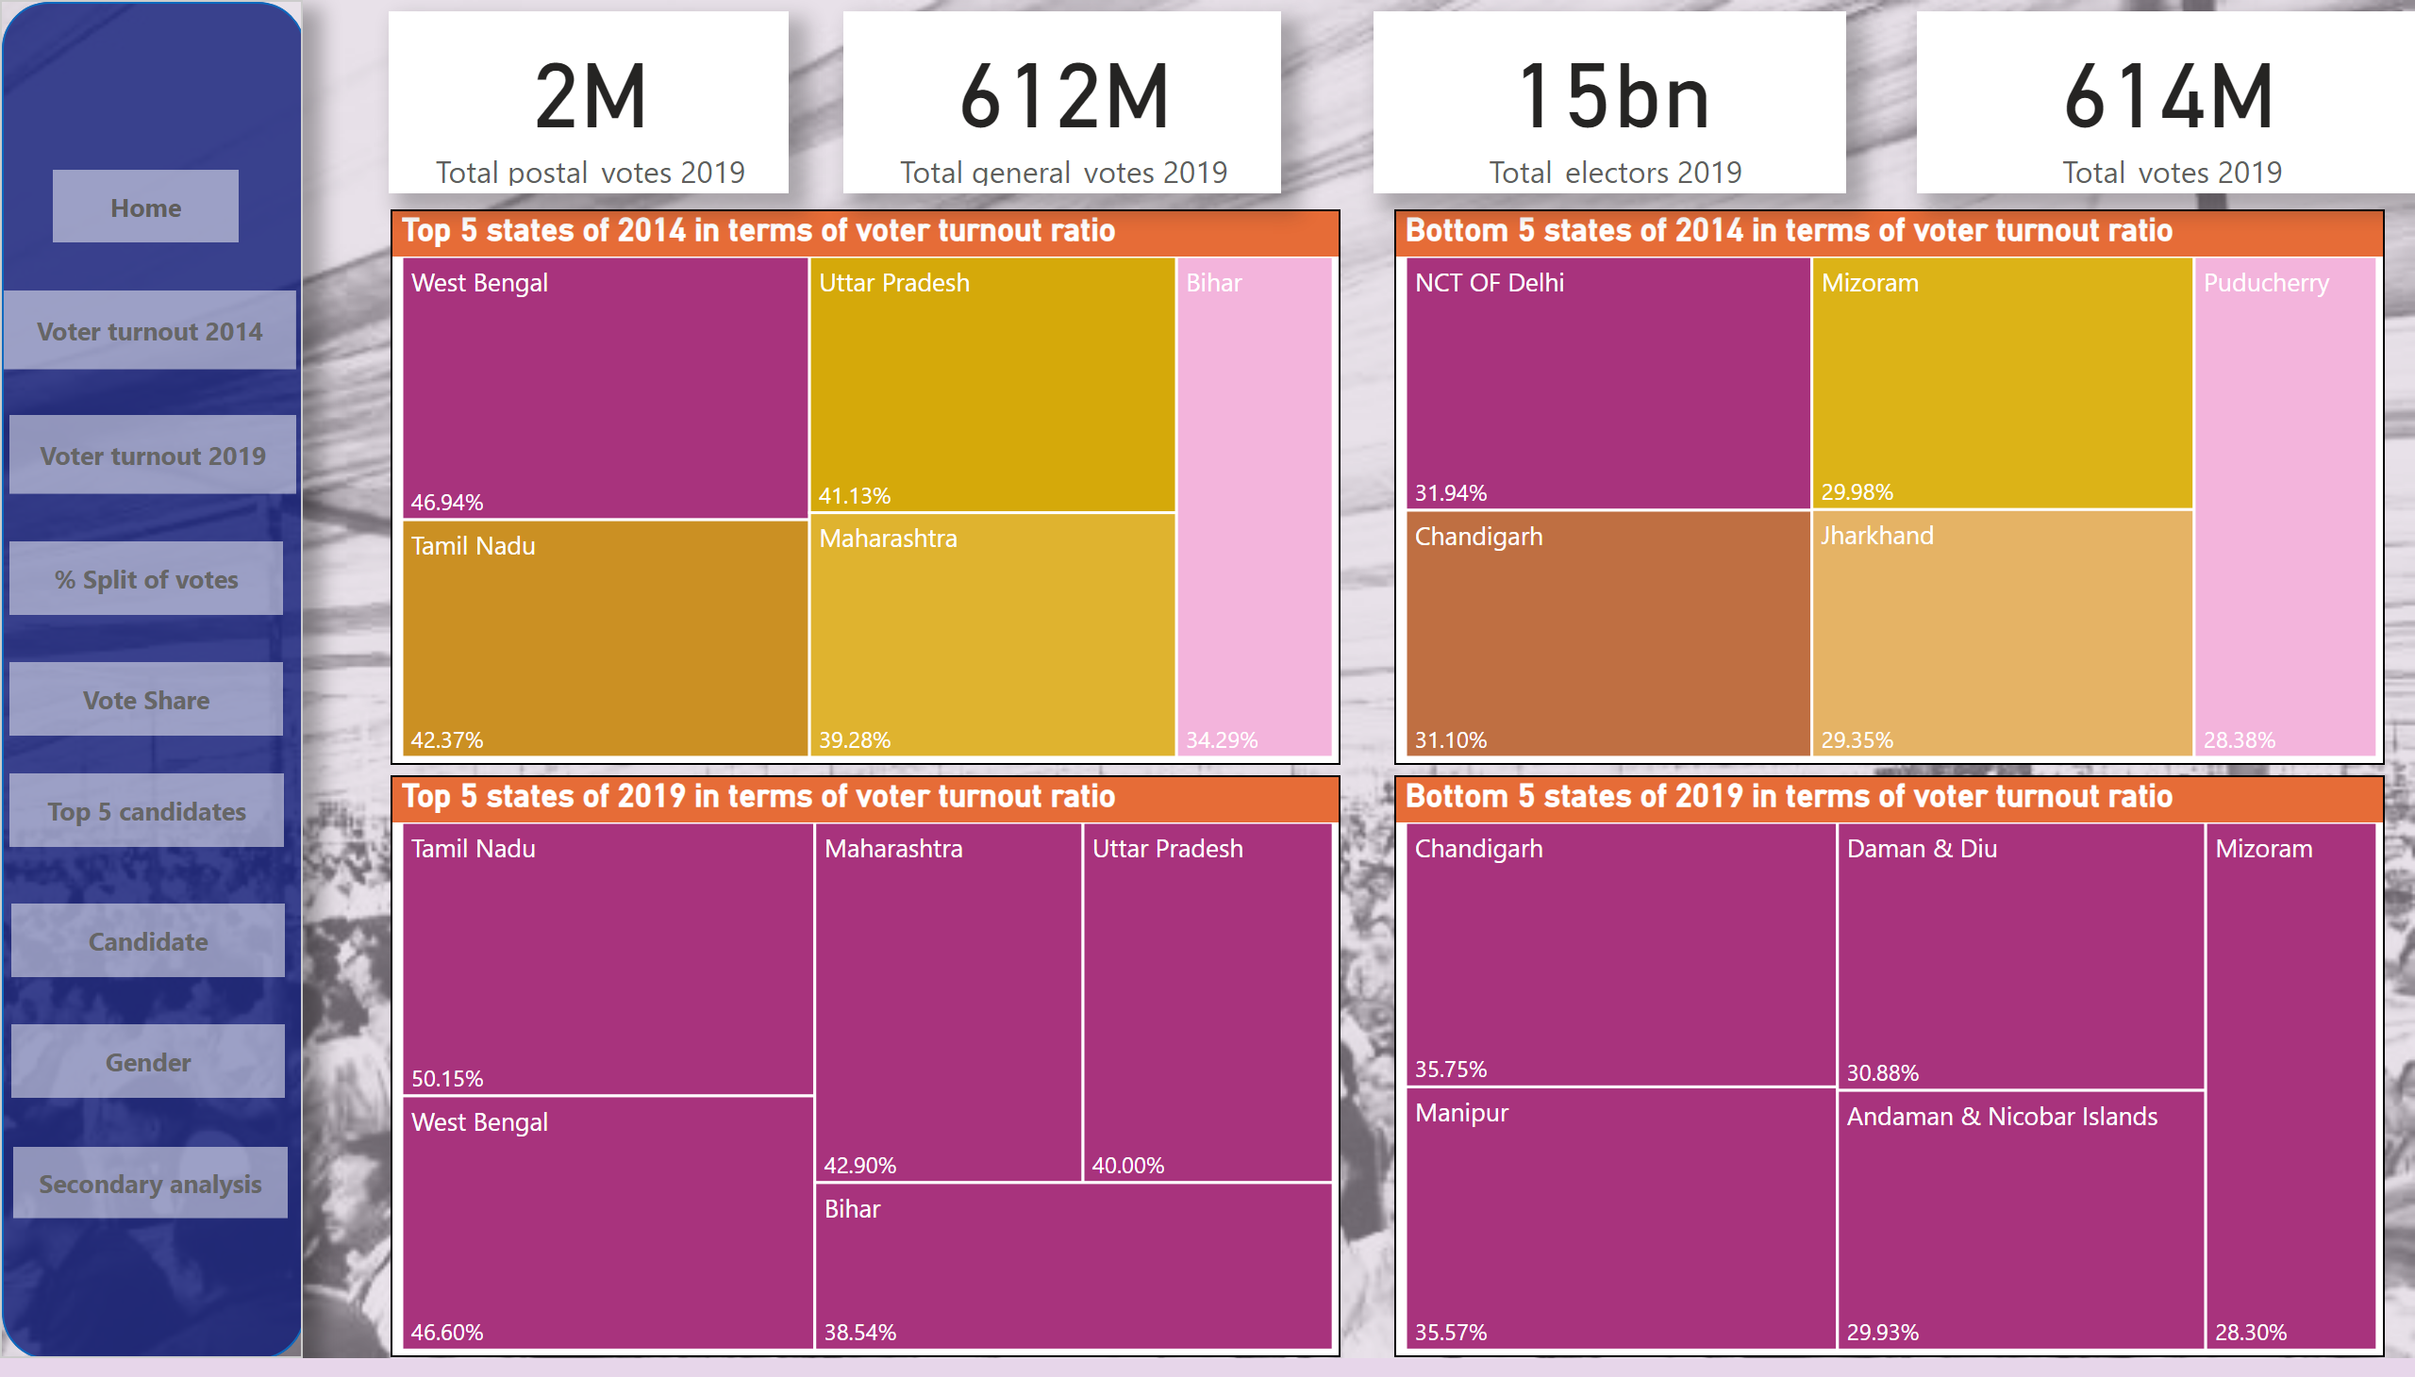
Voter turnout 2019
Notes:
Top 5 states of 2014 in terms of voter turnout ratio
No alt text provided
Bottom 5 states of 2014 in terms of voter turnout ratio
No alt text provided
Top 5 states of 2019 in terms of voter turnout ratio
No alt text provided
Bottom 5 states of 2019 in terms of voter turnout ratio
No alt text provided
card
No alt text provided
card
No alt text provided
card
No alt text provided
card
No alt text provided
shape
No alt text provided
Home
No alt text provided
Voter turnout 1
No alt text provided
Voter turnout 2
No alt text provided
% Split of votes
No alt text provided
Vote share
No alt text provided
Vote share
No alt text provided
Candidate
No alt text provided
Gender
No alt text provided
Gender
No alt text provided

Slide 7
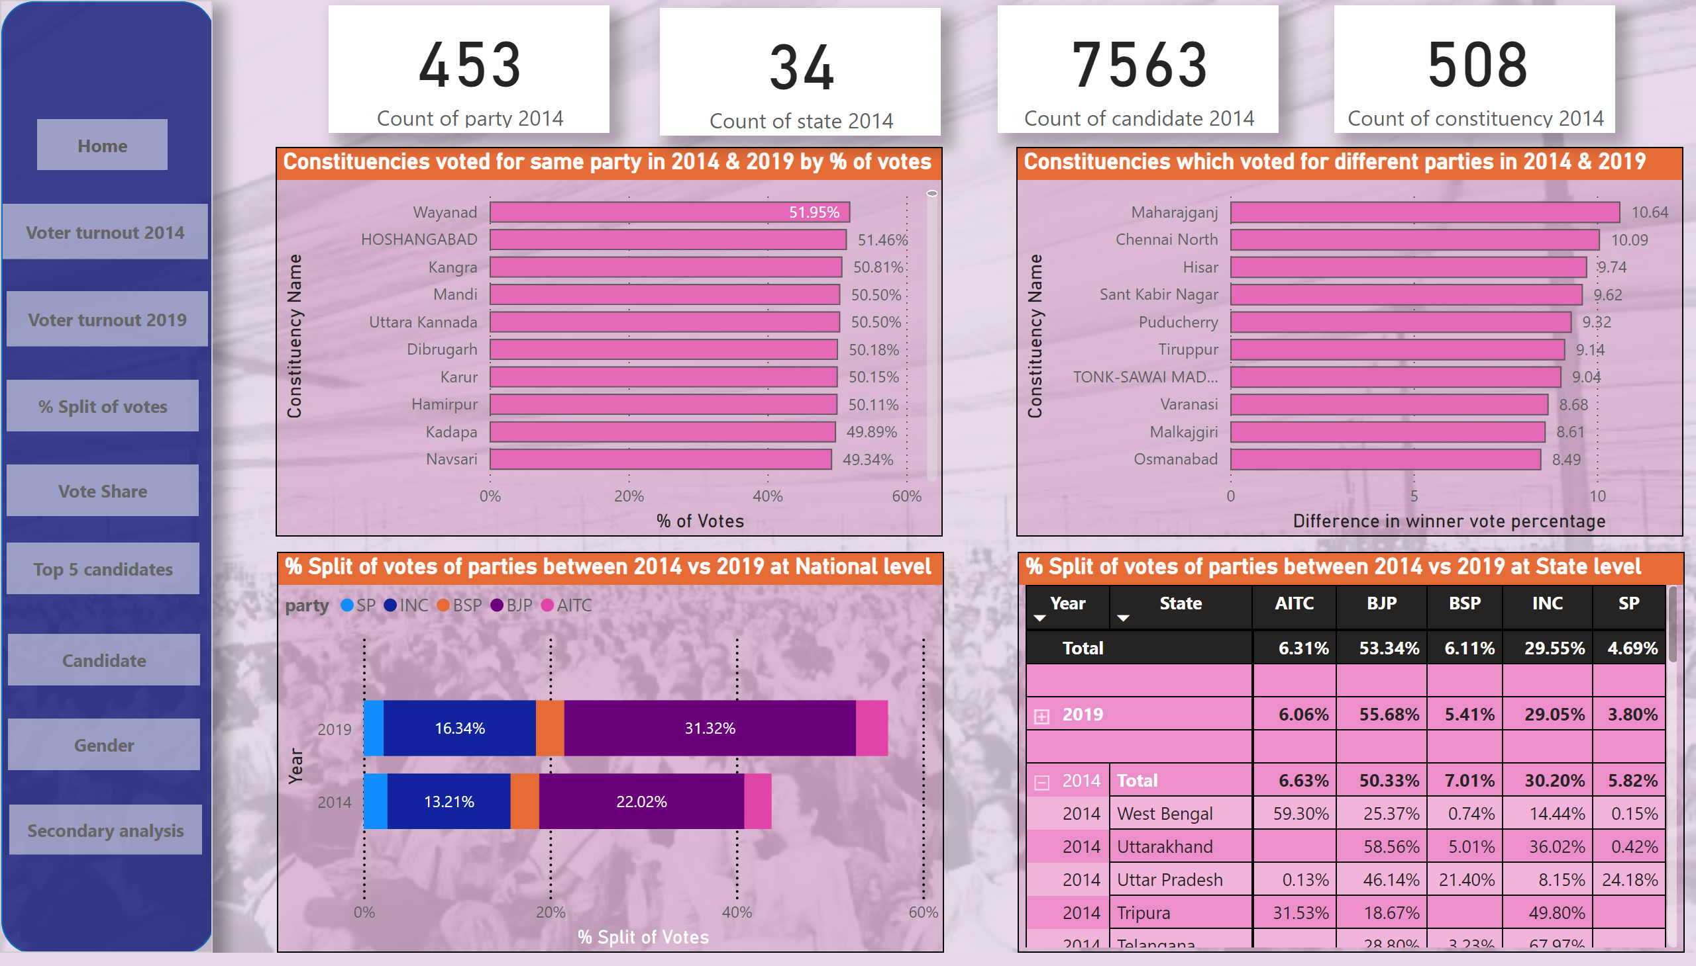
% Split of votes
Notes:
Constituencies voted for same party in 2014 & 2019 by % of votes
No alt text provided
Constituencies which voted for different parties in 2014 & 2019
No alt text provided
% Split of votes of parties between 2014 vs 2019 at National level
No alt text provided
% Split of votes of parties between 2014 vs 2019 at State level
No alt text provided
card
No alt text provided
card
No alt text provided
card
No alt text provided
card
No alt text provided
shape
No alt text provided
Home
No alt text provided
Voter turnout 1
No alt text provided
Voter turnout 2
No alt text provided
% Split of votes
No alt text provided
Vote share
No alt text provided
Vote share
No alt text provided
Candidate
No alt text provided
Gender
No alt text provided
Gender
No alt text provided

Slide 8
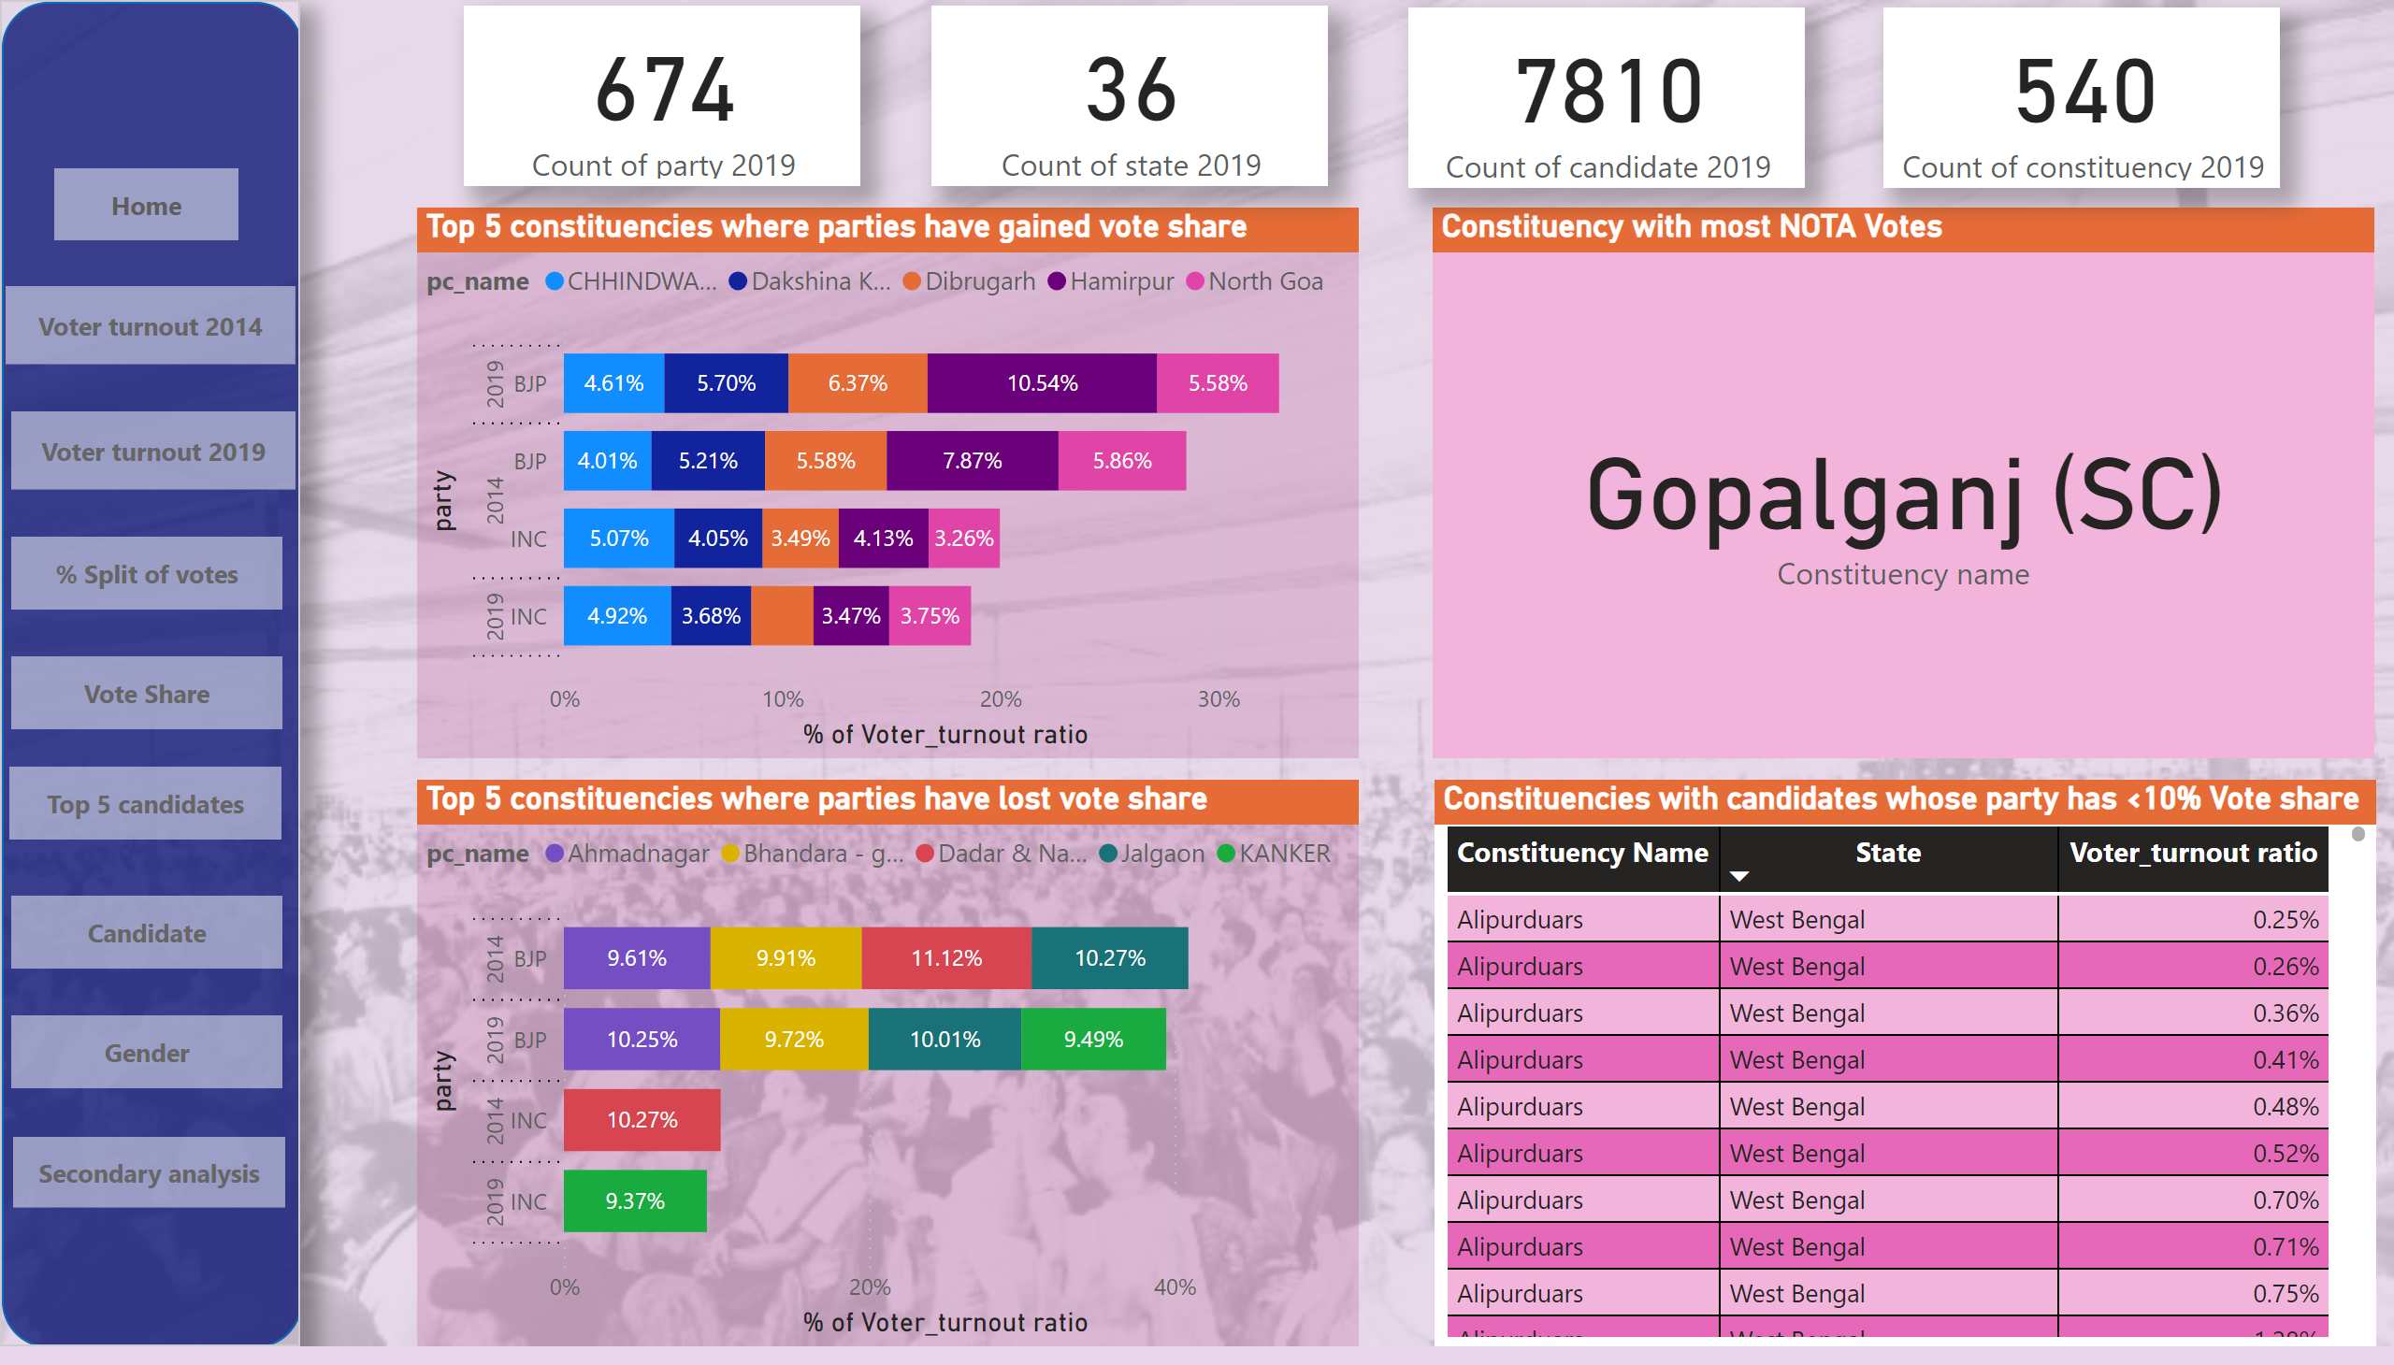
Vote share
Notes:
Top 5 constituencies where parties have gained vote share
No alt text provided
Top 5 constituencies where parties have lost vote share
No alt text provided
Constituency with most NOTA Votes
No alt text provided
Constituencies with candidates whose party has <10% Vote share
No alt text provided
card
No alt text provided
card
No alt text provided
card
No alt text provided
card
No alt text provided
shape
No alt text provided
Voter turnout 1
No alt text provided
Home
No alt text provided
Voter turnout 2
No alt text provided
% Split of votes
No alt text provided
Vote share
No alt text provided
Candidate
No alt text provided
Gender
No alt text provided
Gender
No alt text provided
Vote share
No alt text provided

Slide 9
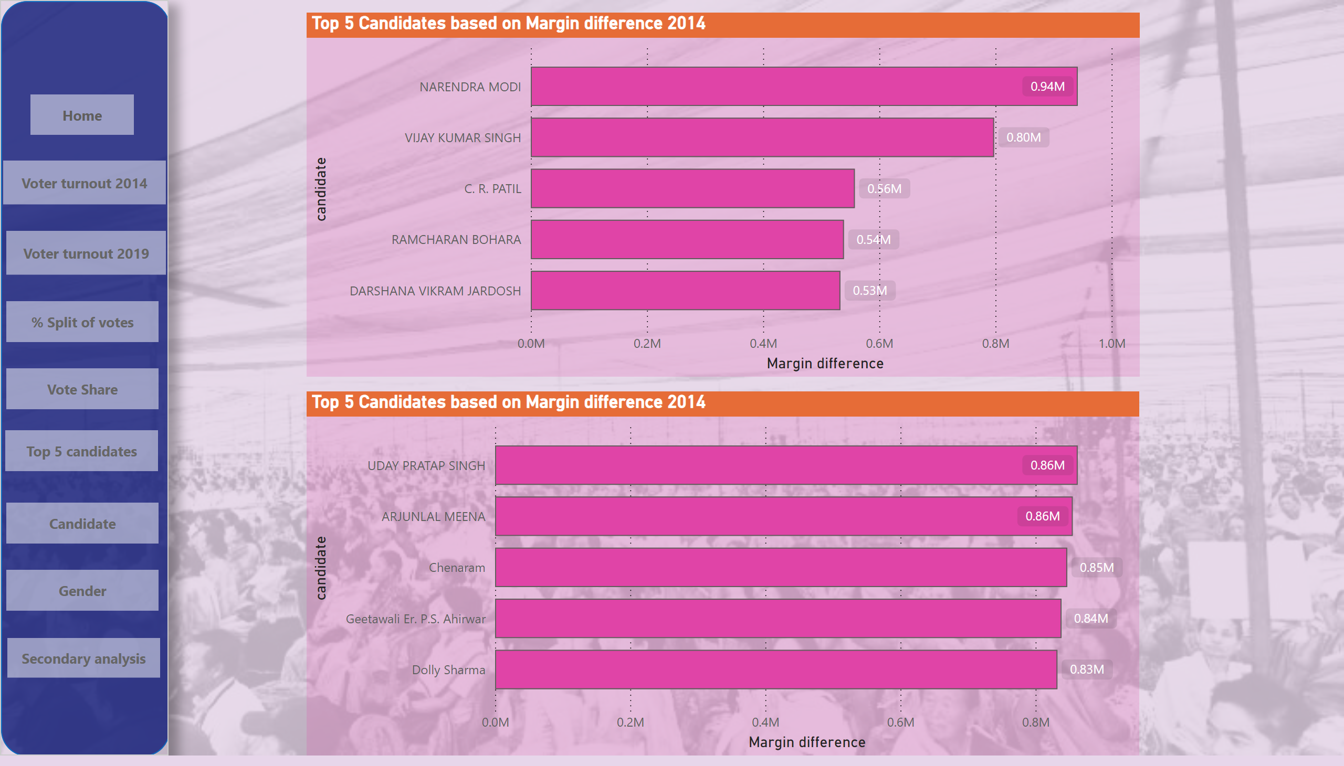
Top 5 candidates
Notes:
shape
No alt text provided
Voter turnout 1
No alt text provided
Home
No alt text provided
Voter turnout 2
No alt text provided
% Split of votes
No alt text provided
Vote share
No alt text provided
Candidate
No alt text provided
Gender
No alt text provided
Gender
No alt text provided
Vote share
No alt text provided
Top 5 Candidates based on Margin difference 2014
No alt text provided
Top 5 Candidates based on Margin difference 2014
No alt text provided

Slide 10
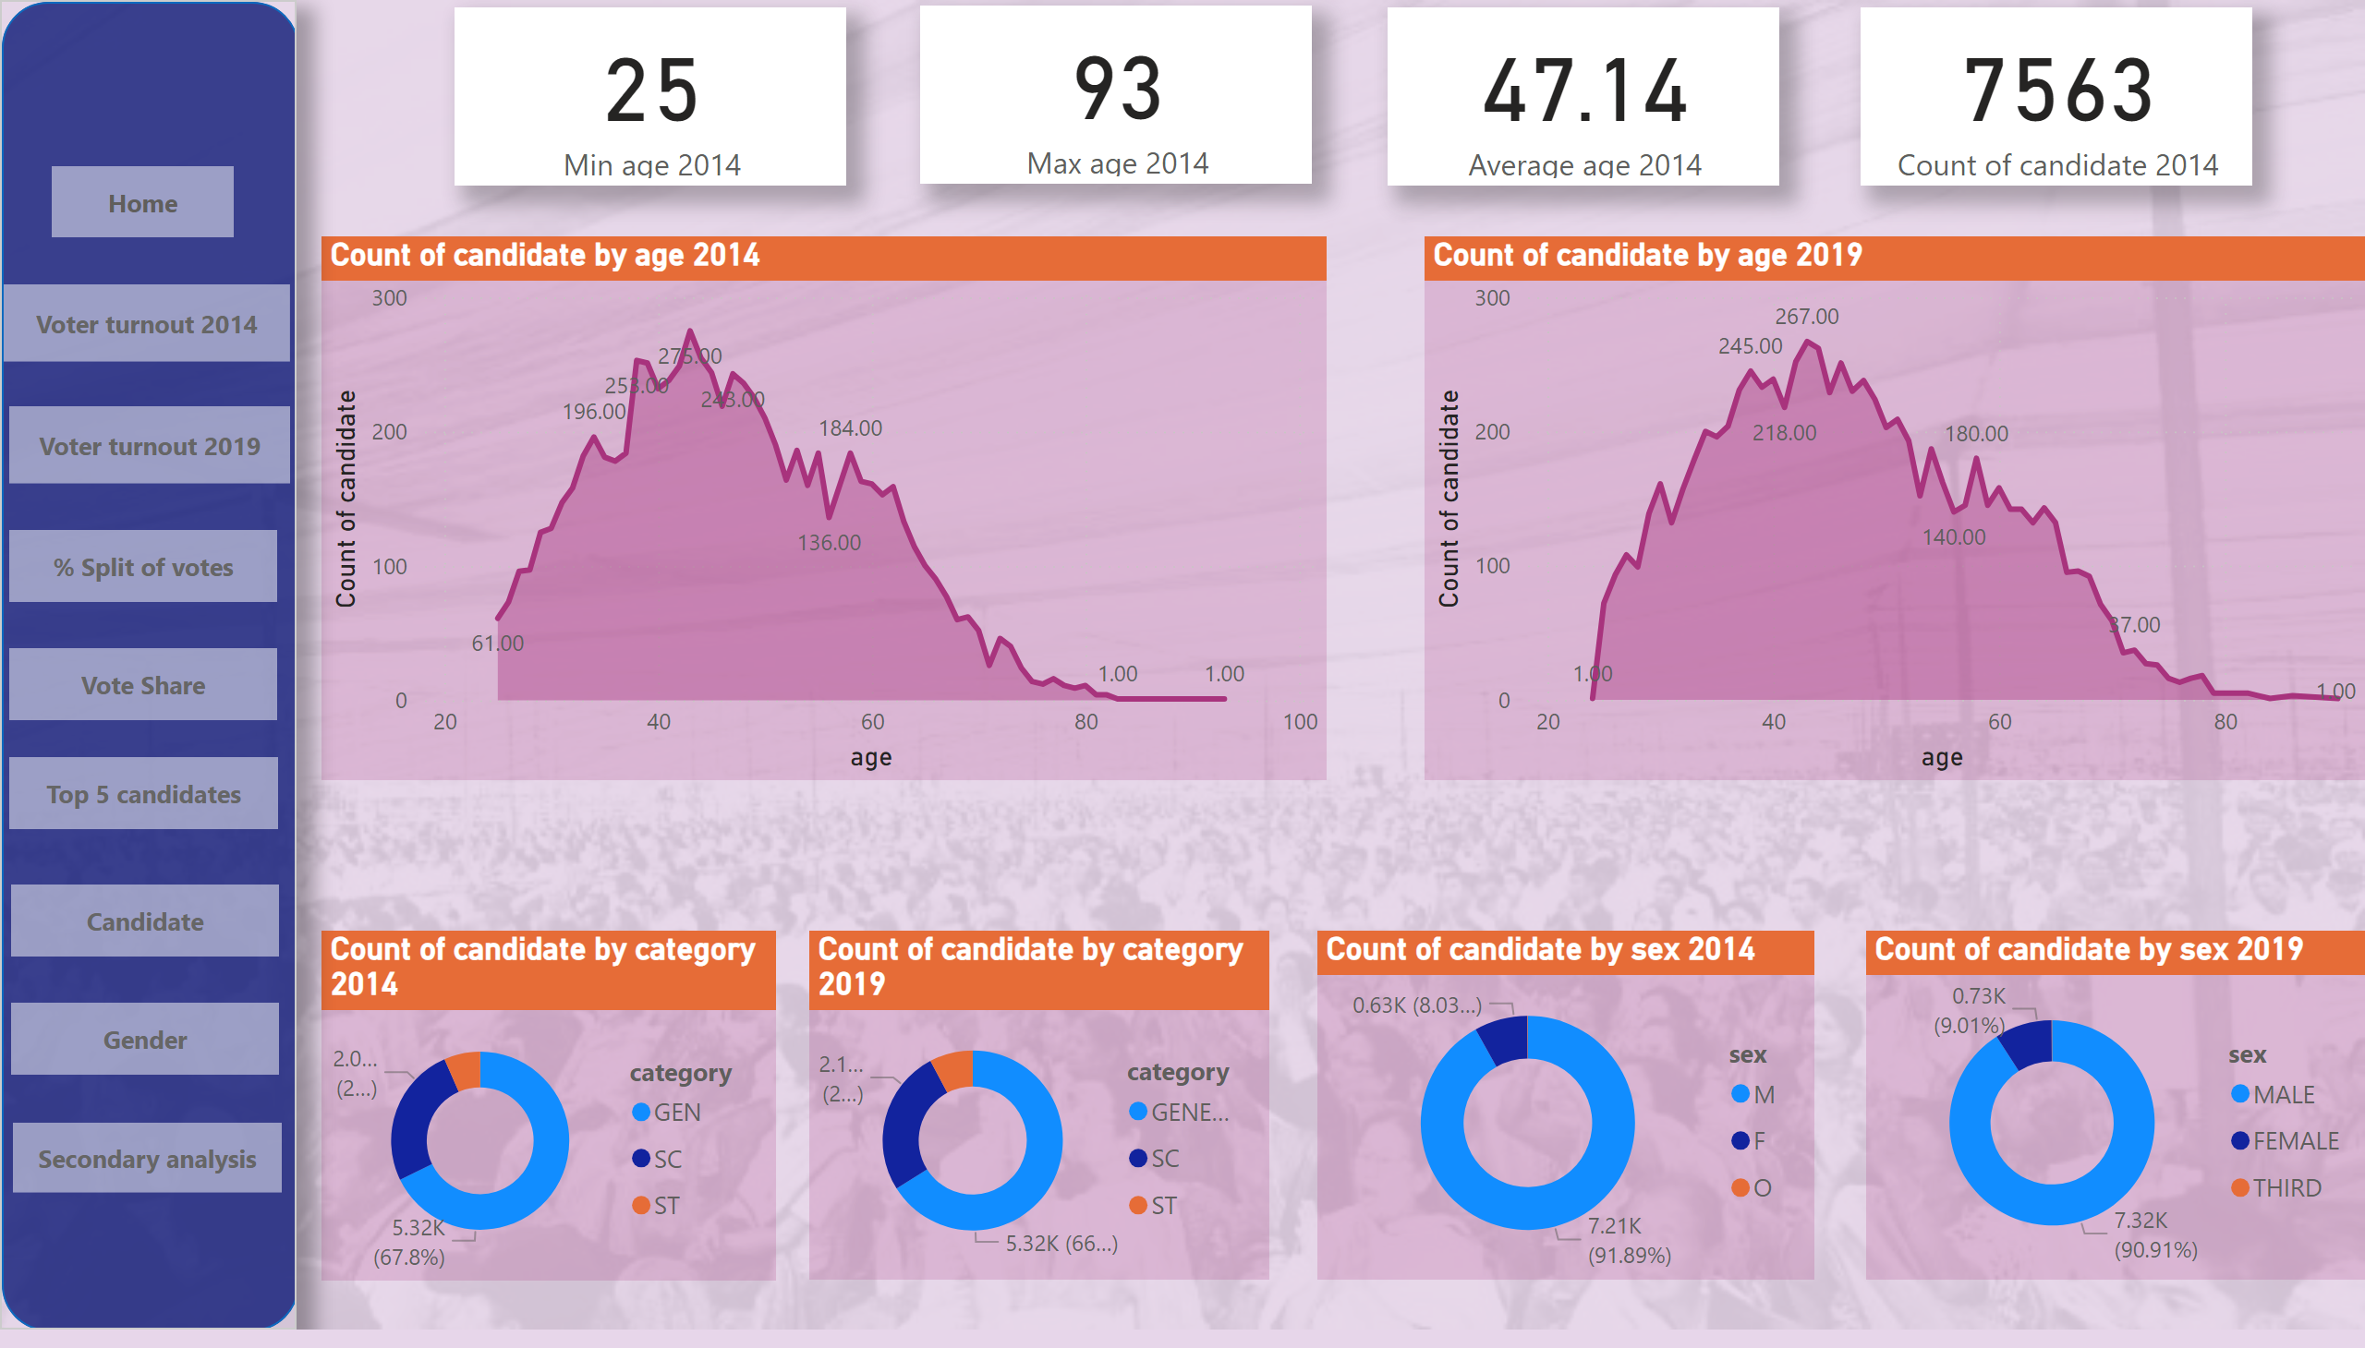
Candidate
Notes:
Count of candidate by category 2019
No alt text provided
Count of candidate by age 2014
No alt text provided
Count of candidate by age 2019
No alt text provided
Count of candidate by sex 2019
No alt text provided
Count of candidate by sex 2014
No alt text provided
Count of candidate by category 2014
No alt text provided
card
No alt text provided
card
No alt text provided
card
No alt text provided
card
No alt text provided
shape
No alt text provided
Home
No alt text provided
Voter turnout 1
No alt text provided
Voter turnout 2
No alt text provided
% Split of votes
No alt text provided
Vote share
No alt text provided
Vote share
No alt text provided
Candidate
No alt text provided
Gender
No alt text provided
Gender
No alt text provided

Slide 11
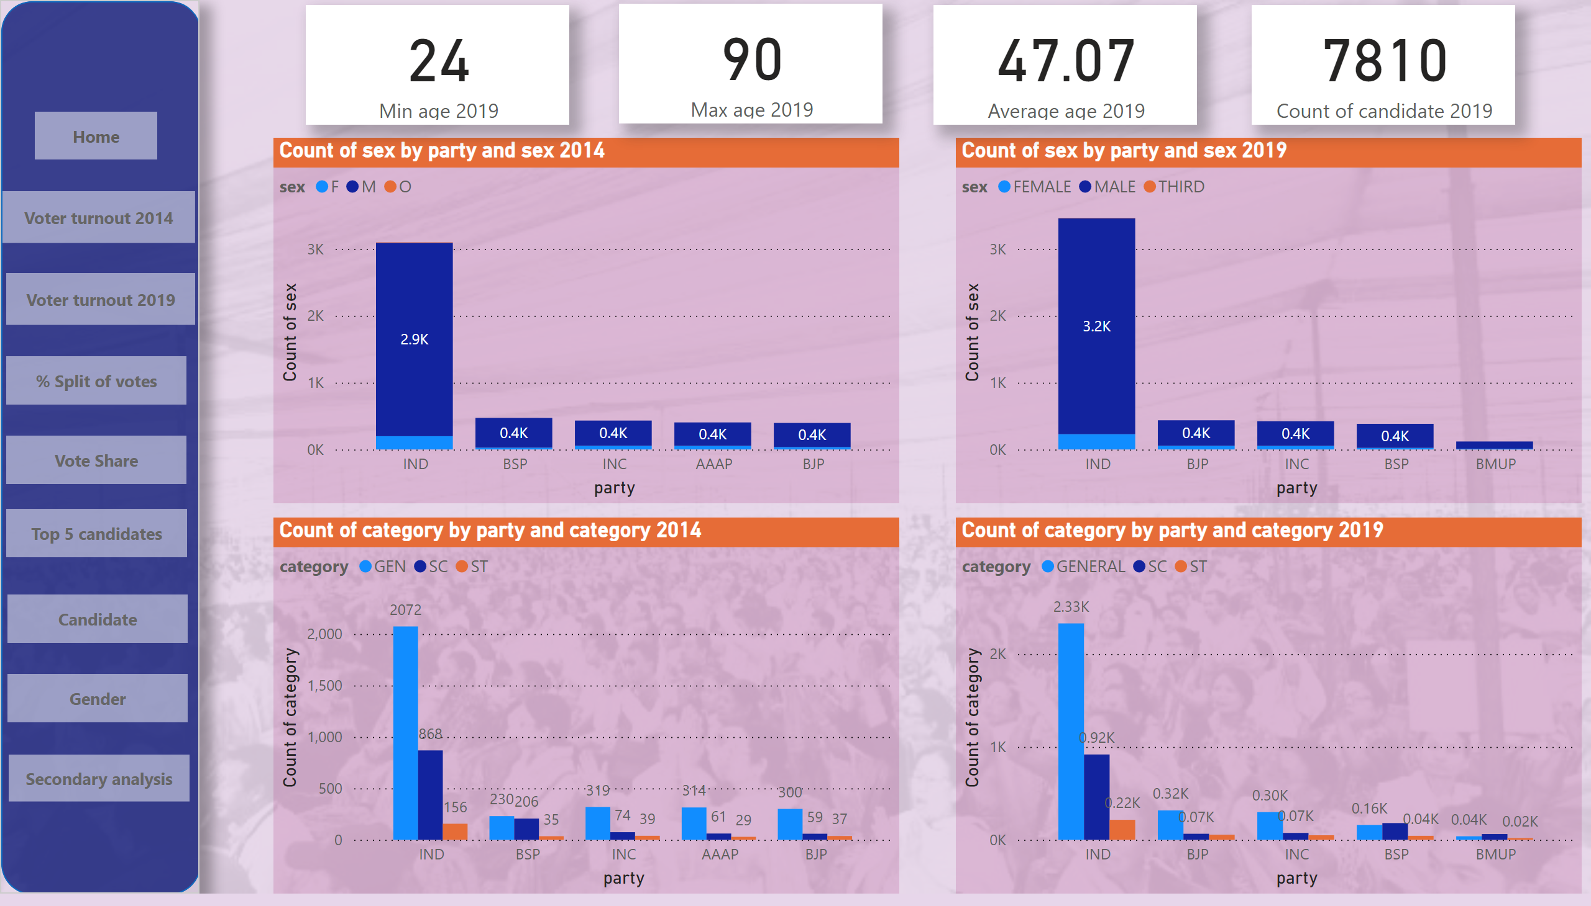
Gender
Notes:
Count of sex by party and sex 2014
No alt text provided
Count of sex by party and sex 2019
No alt text provided
Count of category by party and category 2014
No alt text provided
Count of category by party and category 2019
No alt text provided
card
No alt text provided
card
No alt text provided
card
No alt text provided
card
No alt text provided
shape
No alt text provided
Home
No alt text provided
Voter turnout 1
No alt text provided
Voter turnout 2
No alt text provided
% Split of votes
No alt text provided
Vote share
No alt text provided
Vote share
No alt text provided
Candidate
No alt text provided
Gender
No alt text provided
Gender
No alt text provided

Slide 12
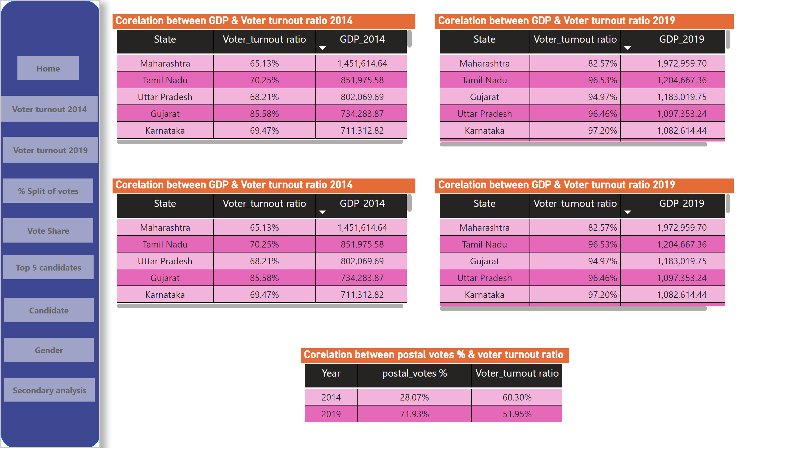
Secondary analysis
Notes:
Corelation between GDP & Voter turnout ratio 2014
No alt text provided
Corelation between GDP & Voter turnout ratio 2019
No alt text provided
Corelation between postal votes % & voter turnout ratio
No alt text provided
Corelation between GDP & Voter turnout ratio 2014
No alt text provided
Corelation between GDP & Voter turnout ratio 2019
No alt text provided
shape
No alt text provided
Home
No alt text provided
Voter turnout 1
No alt text provided
Voter turnout 2
No alt text provided
% Split of votes
No alt text provided
Vote share
No alt text provided
Vote share
No alt text provided
Candidate
No alt text provided
Gender
No alt text provided
Gender
No alt text provided

